Slide 1
Measures of Central Tendency

Slide 2
Measures of central tendency are the center values of a data set.
1. The mean, or average, of numbers is the sum of the numbers divided by .
2. The median of numbers is the middle number when the numbers are written in order. If is even, the median is the average of the two middle numbers.
3. The mode of numbers is the number that occurs most frequently. If two numbers tie for most frequent occurrence, the collection has two modes and is called bimodal.

Slide 3
Advantages and Disadvantages
 | ☺ | ☹
Mean | More sensitive than the median, because it makes use of all the values of the data. | It can be misrepresentative if there is an extreme value.
Median | It is not affected by extreme scores, so can give a representative value. | It is less sensitive than the mean, as it does not take into account all of the values.
Mode | It is useful when the data are in categories, such as the number of babies who are securely attached. | It is not a useful way of describing data when there are several modes.

Slide 4
Measures of Dispersion

Slide 5
Range
The range is the difference between the largest and the smallest observation in the data.
- The prime advantage of this measure of dispersion is that it is easy to calculate.
On the other hand, it has lot of disadvantages.
It is very sensitive to outliers and does not use all the observations in a data set.
It is more informative to provide the minimum and the maximum values rather than providing the range.

Slide 6
Interquartile range
Interquartile range is defined as the difference between the 25th and 75th percentile. Hence the interquartile range describes the middle 50% of observations.
- advantage is that it is not affected by extreme values.
- The main disadvantage in using interquartile range as a measure of dispersion is that it is not amenable to mathematical manipulation.

Slide 7
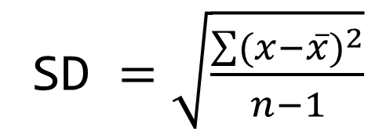
Standard deviation
Standard deviation (SD) is the most commonly used measure of dispersion. It is a measure of spread of data about the mean. SD is the square root of sum of squared deviation from the mean divided by the number of observations.
SD $=\sqrt{\frac{\sum{{(x−\overline{x})}^{2}}}{n−1}}$

Slide 8
Nature of Distributions

Slide 9
Normal Distribution
Normal distribution, also known as the Gaussian distribution, is a probability distribution that is symmetric about the mean, showing that data near the mean are more frequent in occurrence than data far from the mean. In graph form, normal distribution will appear as a bell curve.
The normal distribution model is motivated by the Central Limit Theorem. This theory states that averages calculated from independent, identically distributed random variables have approximately normal distributions, regardless of the type of distribution from which the variables are sampled

Slide 10
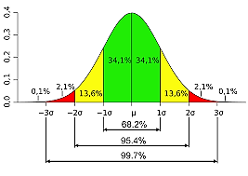

Slide 11
Boxplot
A boxplot is a standardized way of displaying the distribution of data based on a five number summary (“minimum”, first quartile (Q1), median, third quartile (Q3), and “maximum”).
It can tell you about your outliers and what their values are. It can also tell you if your data is symmetrical, how tightly your data is grouped, and if and how your data is skewed.

Slide 12
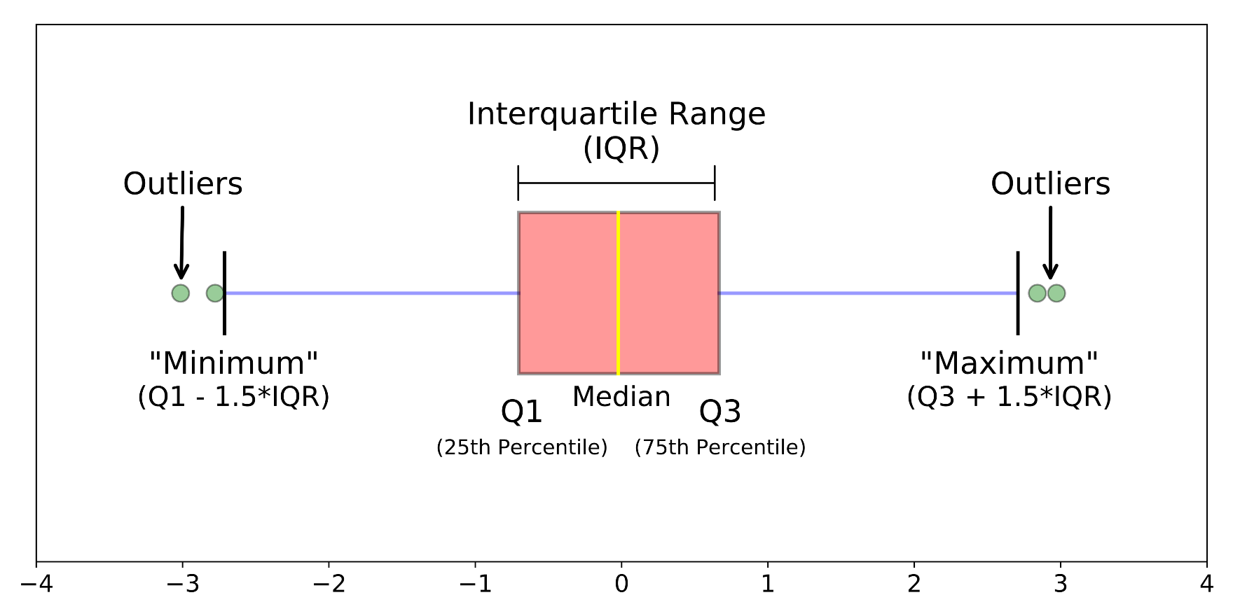

Slide 13
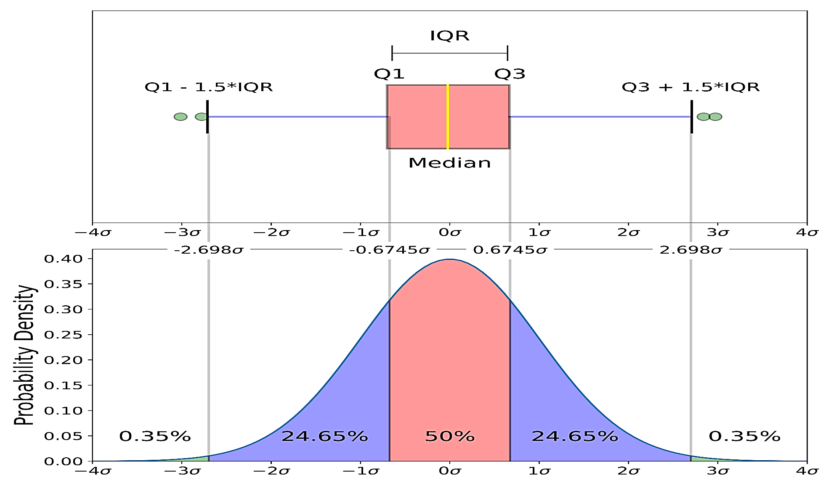
Boxplot on a Normal Distribution

Slide 14
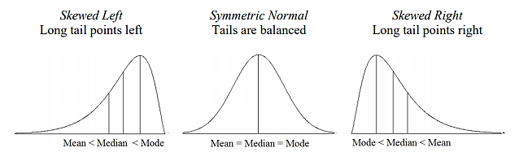
Skewness

Slide 15
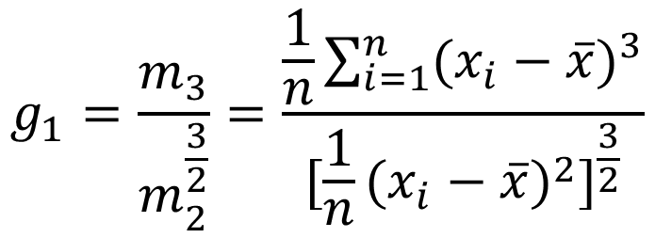
$$g_{1}=\frac{m_{3}}{m_{2}^{\frac{3}{2}}}=\frac{\frac{1}{n}\sum_{i=1}^{n}{{(x_{i}−\overline{x})}^{3}}}{{[\frac{1}{n}{(x_{i}−\overline{x})}^{2}]}^{\frac{3}{2}}}$$
A value of zero means no skewness at all.
A large negative value means the distribution is negatively skewed.
A large positive value means the distribution is positively skewed.

Slide 16
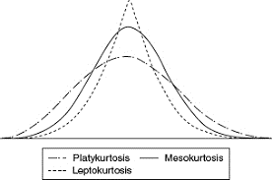
Kurtosis

Slide 17

β₂ is often referred to as “Pearson's kurtosis”, and β₂ − 3 (often symbolized with γ₂, that is γ₂ =β₂ −3) as “kurtosis excess” or “Fisher's kurtosis”.
If Z_{g2} < −2, the population very likely has negative excess kurtosis (kurtosis <3, platykurtic), though you don’t know how much.
If Z_{g2} is between −2 and +2, you can’t reach any conclusion about the kurtosis: excess kurtosis might be positive, negative, or zero.
If Z_{g2} > +2, the population very likely has positive excess kurtosis (kurtosis >3, leptokurtic), though you don’t know how much.

Slide 18
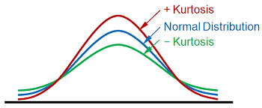

Slide 19
Binomial Distribution
A binomial random variable is the number of successes x in n repeated trials of a binomial experiment. The probability distribution of a binomial random variable is called a binomial distribution.
Binomial Formula. Suppose a binomial experiment consists of n trials and results in x successes. If the probability of success on an individual trial is P, then the binomial probability is:
b(x; n, P) = _{n}C_{x} * P^{x} * (1 - P)^{n - x}

Slide 20
Example 1 Suppose a die is tossed 5 times. What is the probability of getting exactly 2 fours?
Solution: This is a binomial experiment in which the number of trials is equal to 5, the number of successes is equal to 2, and the probability of success on a single trial is 1/6 or about 0.167. Therefore, the binomial probability is:
b(2; 5, 0.167) = ₅C₂ * (0.167)² * (0.833)³ = 0.161

Slide 21
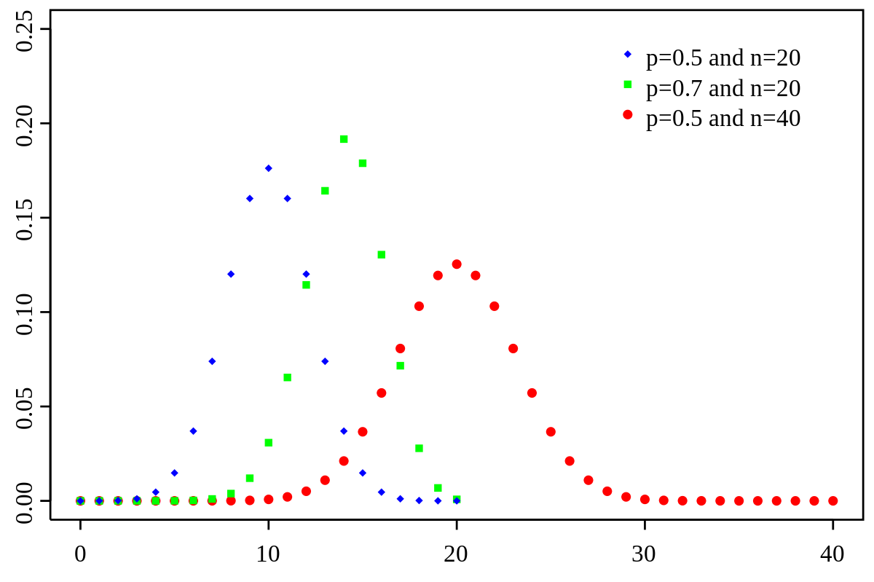

Slide 22
Normalization and Standardization

Slide 23
Normalization typically means that the range of values are "normalized to be from 0.0 to 1.0".
Standardization typically means that the range of values are "standardized" to measure how many standard deviations the value is from its mean.

Slide 24
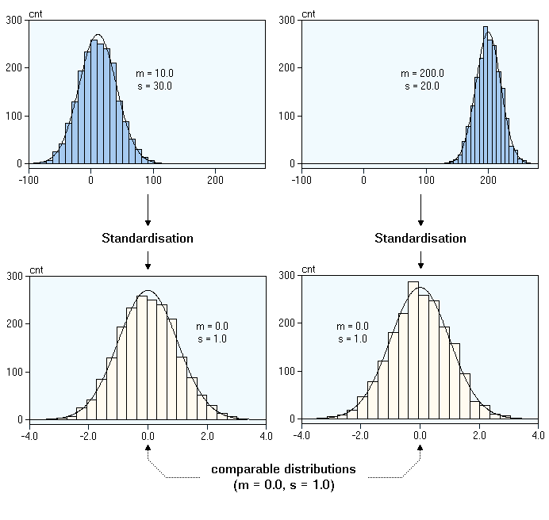

Slide 25
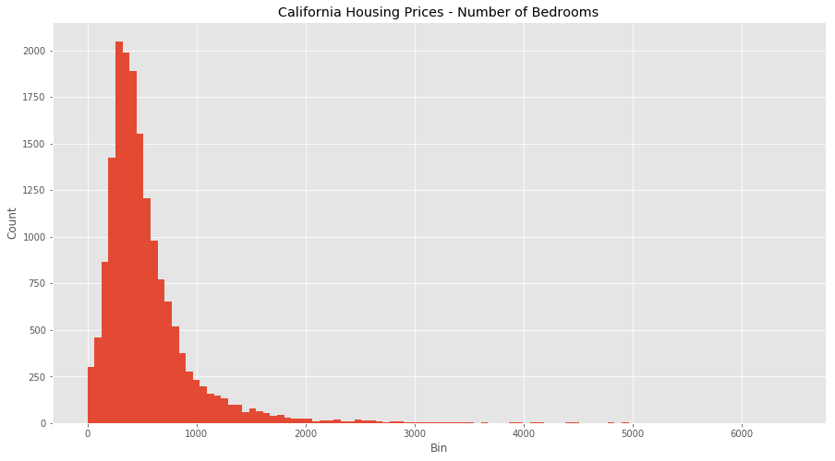
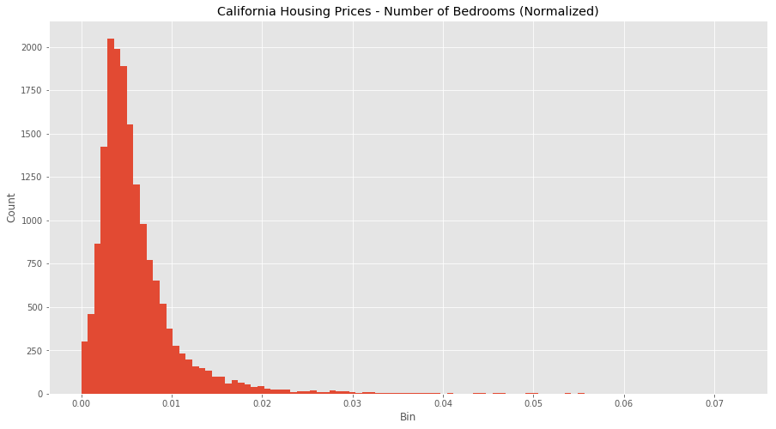

Slide 26
In fact, the only family of algorithms that is scale-invariant are tree-based methods.
Some examples of algorithms where feature scaling matters are:
k-nearest neighbors with an Euclidean distance measure if want all features to contribute equally
k-means clustering
logistic regression, SVMs, perceptrons, neural networks etc. if you are using gradient descent, otherwise some weights will update faster than others.
linear discriminant analysis, principal component analysis, kernel principal component analysis. Need to have features on the same scale since you’d emphasize variables on “larger measurement scales” more.

Slide 27
Z-score standardization or Min-Max scaling?
“Standardization or Min-Max scaling?” - There is no obvious answer to this question: it really depends on the application.
In clustering analyses, standardization may be especially crucial in order to compare similarities between features based on certain distance measures.
Another prominent example is the Principal Component Analysis, where we usually prefer standardization over Min-Max scaling, since we are interested in the components that maximize the variance (if the PCA computes the components via the correlation matrix instead of the covariance matrix).
However, this doesn’t mean that Min-Max scaling is not useful at all! A popular application is image processing, where pixel intensities have to be normalized to fit within a certain range (i.e., 0 to 255 for the RGB color range). Also, typical neural network algorithm require data that on a 0-1 scale.

Slide 28
Thank You

